Slide 1
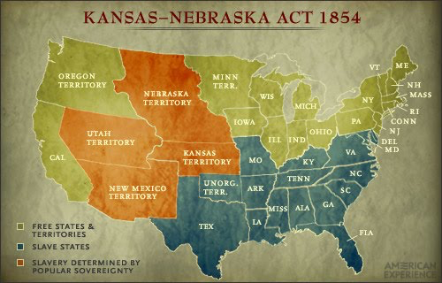
Chapter 16, Lesson 1: “The Search For Compromise”
Do Now:
Read “Lesson 1: The Search for Compromise” on your Chapter 16 Summary. Then, answer the following questions in your S.S. notebook:
What issue was the United States “searching for compromise” on?
Why do you think northerners opposed the Fugitive Slave Act?
What was the Kansas-Nebraska Act?
Notes:
Slavery
They opposed slavery and would be in favor of slaves running away/escaping.
A law passed in 1854 that supported the idea of popular sovereignty when it came to the issue of slavery

Slide 2
Ms. Ample’s Channel Presents: “Kansas-Nebraska Act”

Slide 3
The History Channel Presents: “John Brown and Bleeding Kansas”
As You Watch The Video, Answer The Following Questions:
Who was John Brown?
How many people were killed during the two years of violent protests that swept through Kansas after the passing of the Kansas-Nebraska Act?
John Brown: abolitionist hero OR terrorist/murderer?

