Slide 1
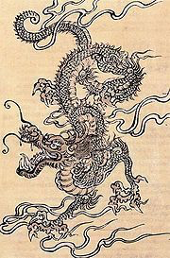
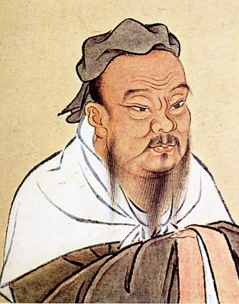
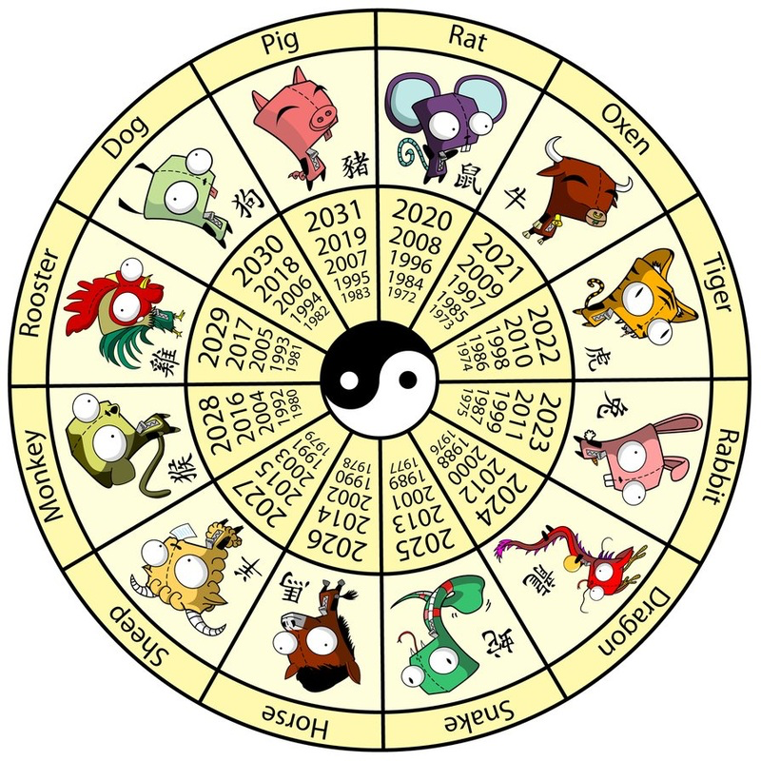
WELCOME TO ANCIENT CHINA!
DO NOW:
Begin working on the “Ancient China Word Search & Cloze Exercise” worksheet that you were given when you arrived.

Slide 2
5 FACTS ABOUT ANCIENT CHINA

Slide 3
EXPLORING THE CHINESE LUNAR CALENDAR & ZODIAC
Directions: Study the Chinese Lunar Calendar diagram that you were given. Find the year of your birth in the outer spokes. Then answer the following questions:
Which animal represents the year of your birth?
What are some character traits associated with the animal and the people born in the year of your birth?
Do you think that the description of your animal sign is reflective of you and your character traits? Why or why not?

Slide 4
Mr. Nicky Presents: “Ancient China”

