Slide 1
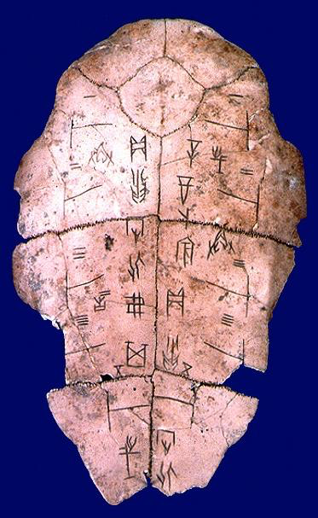
USING CHINESE CHARACTERS
Chinese pictographs and ideographs were first developed and used during the Shang Dynasty. Archaeologists and historians have found evidence of this on the oracle bones that they have uncovered from this time period.
For this activity, you will use Chinese pictographs and ideographs (see the “Chinese Character Card” Handout) to write 5 QUESTIONS that you would ask your ancestors or the gods on an oracle bone.
Each questions MUST include at least ONE Chinese
character.
Design your oracle bone on construction paper
and use your art supplies ☺
Notes:
The Tiber River
Mesopotamia
Hinduism is polytheistic; Buddhism is not.
A system of government in which the people rule.
son of Darius I and ruler of Persia who led the Persian forces at the Battle of Thermopylae

