Slide 1
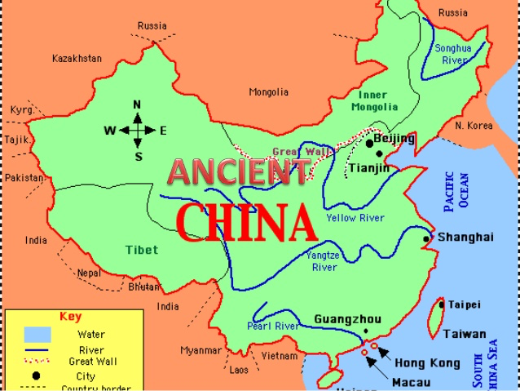
The Geography & Origins of Ancient China
Look at the map above of ancient China OR on pgs. 276-277 in your textbook. Make a list of geographical features that you notice.

Slide 2
BBC Worldwide Presents: “Wild China—The Yellow River”
Notes:
The Tiber River
Mesopotamia
Hinduism is polytheistic; Buddhism is not.
A system of government in which the people rule.
son of Darius I and ruler of Persia who led the Persian forces at the Battle of Thermopylae

Slide 3
TRUE OR FALSE? Reading Challenge
With a partner or two, read pgs. 278-280. Then, complete the accompanying True or False Challenge on the index card that you are given. Turn in your index card when you are finished.
The Huang He River (or “Yellow River”) was named that because of the loess soil it carries downstream, which gives the river a yellowish color.
Since 600 B.C., the Huang He River has flooded 150 times.
The Chang Jiang (or Yangtze River) is the longest river in the world.
Only one-tenth of the land in China can be farmed. This is because much of the land in China is either moutain or desert.
The deserts and mountains of China limited its contacts with other civilizations.
Archaeologists think that people first settled in the Huang He valley because of the warm climate and the frequent, refreshing rainfall.
According to ancient Chinese myth/legend, Yu the Great founded China’s first dynasty, the Xia dynasty.
_____
_____
_____
_____
_____
_____
_____
Notes:
TRUE
FALSE; It has flooded over 1500 times.
FALSE; The Amazon and the Nile are longer.
TRUE
TRUE
FALSE; They first settled in the Huang He valley because of the rich soil.
TRUE

