Slide 1
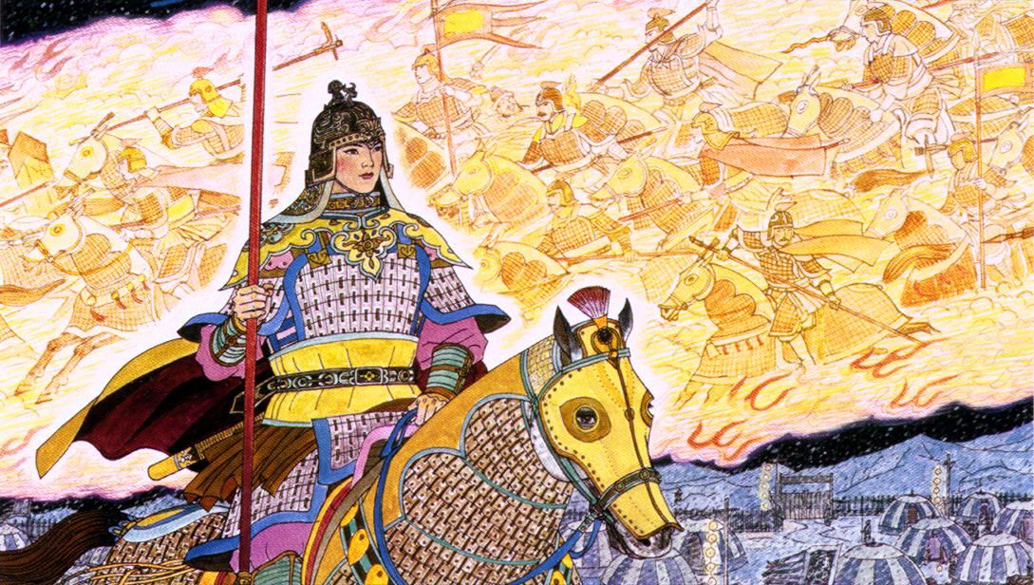
THE BALLAD OF
MULAN
While it is uncertain when Hua Mulan lived, many scholars believe that it was in the period AFTER the Han Dynasty, when China was divided by civil war AND invaders from the north frequently attacked.
Prior to the release of the Disney adaptation of Mulan’s life story, the most well-known account of Hua Mulan’s life was The Ballad of Mulan.
As you read the ballad, reflect on the following questions: Who was Mulan? What did she accomplish? How does her story reflect ancient Chinese values?

