Slide 1
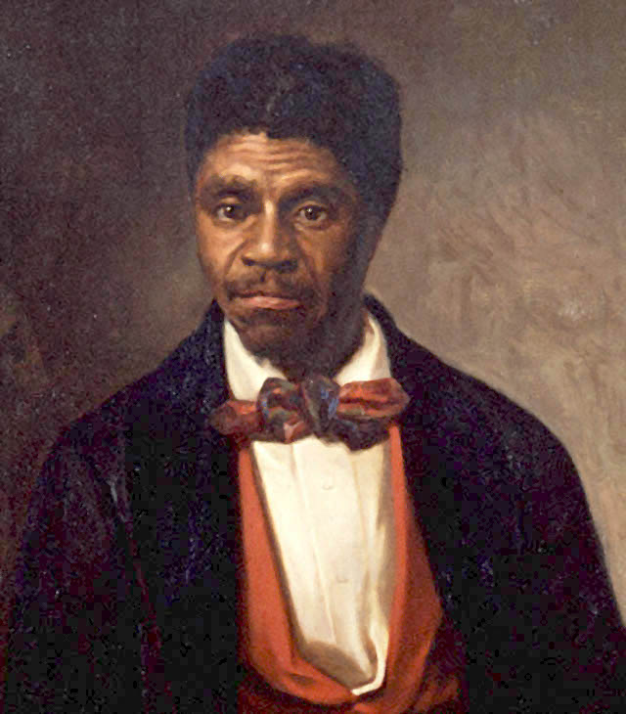
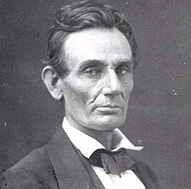
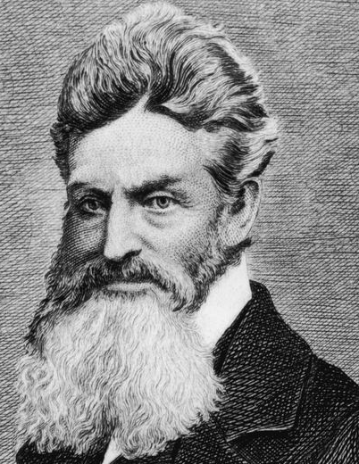
Chapter 16, Lesson 2: “Challenges To Slavery”
1.
2.
3.
Do Now:
Opponent of Slavery Hall of Fame
Three of the most outspoken opponents of slavery in the years leading up to the American Civil War are featured in the portraits above. Can you identify them? In your Social Studies notebook, identify each person that you can and write what you already know (or think you know) about him.

Slide 2
Mr. Betts’ Class Presents: “John Brown” (A Parody of T. Swift’s “Look What You Made Me Do)

Slide 3
Chapter 16, Lesson 2: Questions of the Day
True OR False: When the new Republican party formed in the early 1850s, it consisted of Free-Soilers, antislavery Whigs, and some Democrats?
Why did Dred Scott and his lawyers think that he should be considered, by law, a free man?
Which future president gained a national reputation while campaigning in the Illinois Senate race of 1858?
What was the purpose of John Brown’s raid on Harpers Ferry?
John Brown: Abolitionist hero OR domestic terrorist? What do YOU think AND why?
Notes:
True
Because his master, Dr. Emerson, had taken him to live in free states, like Illinois and Wisconsin.
Abraham Lincoln
John Brown hoped to secure enough arms from the federal arsenal at Harpers Ferry to give to enslaved persons so that they could in turn revolt against their slaveholders.
Answers will vary.

